Slide 1
Approaches Followed by Issues and debates.

Slide 2
Approaches in psychology: Posters
Origins of psychology: Wundt, introspection and the emergence of psychology as a science.
The basic assumptions of the following approaches:
Learning approaches: the behaviourist approach, including classical conditioning and Pavlov’s research, operant conditioning, types of reinforcement and Skinner’s research; social learning theory including imitation, identification, modelling, vicarious reinforcement, the role of mediational processes and Bandura’s research.
The cognitive approach: the study of internal mental processes, the role of schema, the use of theoretical and computer models to explain and make inferences about mental processes. The emergence of cognitive neuroscience.
The biological approach: the influence of genes, biological structures and neurochemistry on behaviour. Genotype and phenotype, genetic basis of behaviour, evolution and behaviour.
The psychodynamic approach: the role of the unconscious, the structure of personality, that is ID, ego and superego, defence mechanisms including repression, denial and displacement, psychosexual stages.
Humanistic psychology: free will, self-actualisation and Maslow’s hierarchy of needs, focus on the self, congruence, the role of conditions of worth. The influence on counselling psychology.
Comparison of approaches.

Slide 3
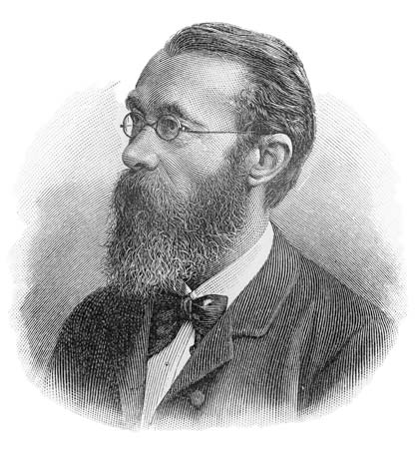
Origins of psychology
Wundt:
Wundt stressed the use of experimental methods drawn from the natural sciences.
in 1879, he established the first psychological laboratory in the world, and two years later he founded the first journal of psychology, Philosophische Studien (“Philosophical Studies”).
Wundt wanted to study the structure of the human mind (using introspection). Wundt believed in reductionism. That is, he believed consciousness could be broken down (or reduced) to its basic elements without sacrificing any of the properties of the whole.
Wundt argued that conscious mental states could be scientifically studied using introspection. Wundt’s introspection was not a causal affair, but a highly practiced form of self-examination. He trained psychology students to make observations that were biased by personal interpretation or previous experience, and used the results to develop a theory of conscious thought.
Therefore, one way Wundt contributed to the development of psychology was to do his research in carefully controlled conditions, i.e. experimental methods. This encouraged other researchers such as the behaviourists to follow the same experimental approach and be more scientific. However, today psychologists (e.g. Skinner) argue that introspection was not really scientific even if the methods used to introspect were. Skinner claims the results of introspection are subjective and cannot be verified because only observable behaviour can be objectively measured.
Wundt concentrated on three areas of mental functioning; thoughts, images and feelings. These are the basic areas studied today in cognitive psychology. This means that the study of perceptual processes can be traced back to Wundt. Wundt’s work stimulated interest in cognitive psychology.

Slide 4
Origins of psychology
Introspection
The examination or observation of one's own mental and emotional processes.
Wundt used controlled experimental methods using introspection.
The term introspection is also used to describe a research technique that was first developed by psychologist Wilhelm Wundt. Also known as experimental self-observation, Wundt's technique involved training people to carefully and objectively as possible analyze the content of their own thoughts.

Slide 5
Origins of psychology
Emergence of psychology as a science
Science uses an empirical approach. Empiricism (founded by John Locke) states that the only source of knowledge comes through our senses – e.g. sight, hearing etc.
This was in contrast to the existing view that knowledge could be gained solely through the powers of reason and logical argument (known as rationalism). Thus, empiricism is the view that all knowledge is based on, or may come from experience.
The nature of scientific inquiry may be thought of at two levels:
1. that to do with theory and the foundation of hypotheses.
2. and actual empirical methods of inquiry (i.e. experiments, observations)
Wilheim Wundt developed the first psychology lab in 1879. Introspection was used, but systematically (i.e. methodologically). It was really a place from which to start thinking about how to employ scientific methods to investigate behavior.
The classic movement in psychology to adopt these strategies were the behaviourists, who were renowned for their reliance on controlled laboratory experiment and rejection of any unseen or subconscious forces as causes of behaviour. And later, the cognitive psychologists adopted this rigorous (i.e. careful), scientific, lab based approach too.

Slide 6
What is a science
Write 5 things that make science a science!

Slide 7
Science
Empirical Evidence
Refers to data being collected through direct observation or experiment.
Empirical evidence does not rely on argument or belief.
Instead, experiments and observations are carried out carefully and reported in detail so that other investigators can repeat and attempt to verify the work.
Objectivity
Researchers should remain totally value free when studying; they should try to remain totally unbiased in their investigations. I.e. Researchers are not influenced by personal feelings and experiences.
Objectivity means that all sources of bias are minimized and that personal or subjective ideas are eliminated. The pursuit of science implies that the facts will speak for themselves, even if they turn out to be different from what the investigator hoped.
Control
All extraneous variables need to be controlled in order to be able to establish cause (IV) and effect (DV).
Hypothesis testing
E.g. a statement made at the beginning of an investigation that serves as a prediction and is derived from a theory. There are different types of hypotheses (null and alternative), which need to be stated in a form that can be tested (i.e. operationalized and unambiguous).

Slide 8
Science
Replication
This refers to whether a particular method and finding can be repeated with different/same people and/or on different occasions, to see if the results are similar.
If a dramatic discovery is reported, but it cannot be replicated by other scientists it will not be accepted.
If we get the same results over and over again under the same conditions, we can be sure of their accuracy beyond reasonable doubt.
This gives us confidence that the results are reliable and can be used to build up a body of knowledge or a theory: vital in establishing a scientific theory.
Predictability
We should be aiming to be able to predict future behavior from the findings of our research.

Slide 9
The major features of introspection
Focus on being objective
Reflection on sensations, feelings and images
Wundt would ask people to focus on an everyday object and look inwards noticing sensations and feelings and images
Breaking thoughts about an object down into separate elements
Systematic reporting of an experience of object
Specific examples eg use of metronome

Slide 10
Origins of psychology: Wundt, introspection and the emergence of psychology as a science.

Slide 11
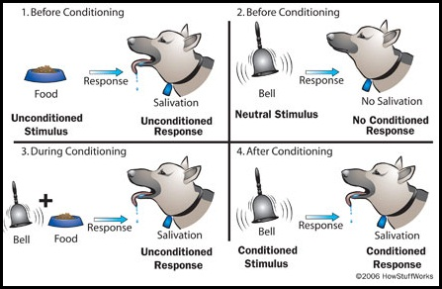
Learning approaches: The behaviourist approach
Classical conditioning and Pavlov’s research:
Pavlov (1902) started from the idea that there are some things that a dog does not need to learn. For example, dogs don’t learn to salivate whenever they see food. This reflex is ‘hard wired’ into the dog. In behaviourist terms, it is an unconditioned response

Slide 12
Operant conditioning, types of reinforcement and Skinner’s research
POSITIVE AND NEGATIVE REINFORCERS
Positive reinforcers are favourable events or outcomes that are given to the individual after the desired behaviour. This may come in the form of praise, rewards, etc.
Negative reinforcers typically are characterized by the removal of an undesired or unpleasant outcome after the desired behaviour. A response is strengthened as something considered negative is removed.
The goal in both of these cases of reinforcement is for the behaviour to increase.
The following are some examples of positive reinforcement:
A mother gives her son praise (positive stimulus) for doing homework (behaviour).
The little boy receives £5.00 (positive stimulus) for every A he earns on his report (behaviour).
A father gives his daughter candy (positive stimulus) for cleaning up toys (behaviour).

Slide 13
Operant part 2: POSITIVE AND NEGATIVE PUNISHMENT
What is Positive Punishment?
Positive punishment works by presenting a negative consequence after an undesired behaviour is exhibited, making the behaviour less likely to happen in the future. The following are some examples of positive punishment:
A child picks his nose during class (behaviour) and the teacher reprimands him (negative stimulus) in front of his classmates.
A child grabs a toy from another child (behaviour) and is sent to time out (negative stimulus)
What is Negative Punishment?
Negative punishment happens when a certain desired stimulus is removed after a particular undesired behaviour is exhibited, resulting in the behaviour happening less often in the future.
The following are some examples of negative punishment:
For a child that really enjoys a specific class, such as gym or music classes at school, negative punishment can happen if they are removed from that class (desired stimulus) and sent to the Head’s office because they were acting out/misbehaving (behaviour).
If a child does not follow directions or acts inappropriately (behaviour), he loses a token for good behaviour (desired stimulus) that can later be cashed in for a prize.
Siblings get in a fight (behaviour) over who gets to go first in a game or who gets to play with a new toy, the parent takes the game/toy away (desired stimulus).

Slide 14
In behaviourism positive and negative does not mean good and bad.
Positive means +
Negative means –
Think of it as positive (+) – positive always refers to adding something, in this case you are adding in a spank.
think of negative (-) – negative always refers to taking away something, in this case taking away a mobile phone

Slide 15
Example game:
If I take away your cell phone because you were texting in class, that is a negative consequence.
It is also a removal, so it is negative punishment.
After the child acts out or does something wrong (undesired behaviour), the caregiver spanks (adds a negative consequence) the child, this makes the behaviour less likely to happen.
Spanking a child would be considered positive punishment.

Slide 16
social learning theory
What do you think?
Bandura and the bobo doll.
Bandura explained:
"Learning would be exceedingly laborious, not to mention hazardous, if people had to rely solely on the effects of their own actions to inform them what to do. Fortunately, most human behaviour is learned observationally through modelling: from observing others one forms an idea of how new behaviours are performed, and on later occasions this coded information serves as a guide for action."
Albert Bandura, Social Learning Theory, 1977

Slide 17
There are four mediational processes proposed by Bandura:
Attention: The extent to which we are exposed/notice the behaviour. For a behaviour to be imitated it has to grab our attention. We observe many behaviours on a daily basis and many of these are not noteworthy. Attention is therefore extremely important in whether a behaviour has an influence in others imitating it.
Retention: How well the behaviour is remembered. The behaviour may be noticed, but is it not always remembered which obviously prevents imitation. It is important therefore that a memory of the behaviour is formed to be performed later by the observer.
Much of social learning is not immediate so this process is especially vital in those cases. Even if the behaviour is reproduced shortly after seeing it, there needs to be a memory to refer to.
Reproduction: This is the ability to perform the behaviour that the model has just demonstrated. We see much behaviour on a daily basis that we would like to be able to imitate but that this not always possible. We are limited by our physical ability and for that reason, even if we wish to reproduce the behaviour, we cannot.
This influences our decisions whether to try and imitate it or not. Imagine the scenario of a 90-year-old-lady who struggles to walk watching Dancing on Ice. She may appreciate that the skill is a desirable one, but she will not attempt to imitate it because she physically cannot do it.
Motivation: The will to perform the behaviour. The rewards and punishment that follow a behaviour will be considered by the observer. If the perceived rewards outweighs the perceived costs (if there are any) then the behaviour will be more likely to be imitated by the observer. If the vicarious reinforcement is not seen to be important enough to the observer then they will not imitate the behaviour

Slide 18
Spot the word. Imitation, identification, modelling, Vicarious reinforcement.
Observational learning involves a number of cognitive and behavioural processes. In order to learn the behaviour of another, the person must first pay attention to what the other person (called a model) is doing. They must then encode and form a memory of the behaviour the model performs. At a later time, this memory must be translated back into a behaviour so that the observer may imitate it. In order to imitate the behaviour effectively the observer may need to practise it. Whether or not the observer actually makes use of the behaviour they have learned depends on whether they are motivated to do so. The observer’s motivation may be affected by several factors, principally, whether they believe that reinforcement is available if they imitate. Their beliefs may be influenced by the consequences of their past behaviour (as in behaviourism) but also by the observed consequences of the model’s behaviour. If the model is observed to be reinforced for their actions, then imitation becomes more likely, assuming that the observer values the reinforcer that the model was observed to get. Conversely, if the model is observed to be punished then imitation becomes less likely (these processes are called vicarious reinforcement and punishment). A number of factors besides reinforcement and punishment influence whether a particular person is likely to be selected as a model and imitated. Models are more likely to be imitated if the observer perceives them to be similar to themselves (Identification). Imitation is also more likely when the model has high status and is attractive and when the observer has low self-esteem.

Slide 19
The role of mediational processes and Bandura’s research.
SLT is often described as the ‘bridge’ between traditional learning theory (ie. behaviourism) and the cognitive approach. This is because it focuses on how mental (cognitive) factors are involved in learning.
Unlike Skinner, Bandura (1977) believes that humans are active information processors and think about the relationship between their behaviour and its consequences. Observational learning could not occur unless cognitive processes were at work. These mental factors mediate (i.e. intervene) in the learning process to determine whether a new response is acquired.
Therefore, individuals do not automatically observe the behaviour of a model and imitate it. There is some thought prior to imitation and this consideration is called mediational processes. This occurs between observing the behaviour (stimulus) and imitating it or not (response)

Slide 20
mediational processes in learning
Credit mediational processes relevant to Bradley’s situation e.g.
mental/cognitive processes occur between stimulus (Bradley’s observation) and
response (Bradley’s copying the behaviour).
specific examples here are: attention, motivation, retention/memory, assessment of own ability.
Bradley is motivated to attend to the relevant information (is keen to play well).
Bradley pays attention to the actions of the person he wants to copy (watches carefully).
Bradley tries to remember the action so he can do the same (thinks about how he was holding the cue).
Bradley considers his own ability to perform (thinks…whether he can do the same.)

Slide 21
The cognitive approach:
The study of internal mental processes, the role of schema, the use of theoretical and computer models to explain and make inferences about mental processes. The emergence of cognitive neuroscience.

Slide 22
The cognitive approach:

Slide 23
The cognitive approach:
The study of internal mental processes, the role of schema, the use of theoretical and computer models to explain and make inferences about mental processes. The emergence of cognitive neuroscience.

Slide 24
schema
A schema is a set of ideas or a pattern of thought about a particular concept or situation. For example, we have a schema about school, and a schema about friendship. The cognitive approach states that information is not stored separately in the mind, but items are linked together meaningfully. This means that information can be distorted, as seen in studies of eyewitness testimony, As shown by Bartlett (1932), schemas are based on our culture.

Slide 25
The use of theoretical and computer models to explain and make inferences about mental processes
The cognitive approach looks not just at inputs to the person and their behavioural output, but instead focuses on the many mental processes in-between. Examples of key cognitive processes include memory, perception, beliefs and language processes.
Initially the approach used a computer metaphor, comparing the mind to a computer processor. This is limited, however, because there are important differences in the way we take in and represent information. For example, memories tend to be connected to previous memories, rather than stored as separate items.

Slide 26
The emergence of cognitive neuroscience
The field of cognitive neuroscience concerns the scientific study of the neural mechanisms underlying cognition and is a branch of neuroscience.
Cognitive neuroscience overlaps with cognitive psychology, and focuses on the neural substrates of mental processes and their behavioural manifestations.
Cognitive neuroscientists tend to have a background in experimental psychology, neurobiology, neurology, physics, and mathematics.
Methods employed in cognitive neuroscience include psychophysical experiments, functional neuroimaging, electrophysiological studies of neural systems and, increasingly, cognitive genomics and behavioural genetics.
Clinical studies in psychopathology in patients with cognitive deficits constitute an important aspect of cognitive neuroscience.
The main theoretical approaches are computational neuroscience and the more traditional, descriptive cognitive psychology theories such as psychometrics.

Slide 27
Cognitive theory of depression
Ellis ABC model Activating, Beliefs (irrational), Consequences
Becks cognitive triad (Negative views)

Slide 28
The brain.
fMRI
The brain

Slide 29
Exam Question
Outline what is meant by Cognitive neuroscience and describe one practical application of cognitive neuroscience? 6

Slide 30
Exam answer cognitive neuroscience
Possible content:
  Scientific study of brain/neurological structures, mechanisms, processes, chemistry
  That are responsible for cognitive/mental/thinking processes
Possible applications:
  Use of scanning/imaging techniques eg to locate different types of memory in different areas of the brain leading to treatment for memory problems
  Use of scanning/imaging techniques to study mental processing patients with depression or OCD or in children with autism or dyslexia.
  Use of imaging techniques and angiography to study the effects of normal ageing on the brain or to observe the effects of stroke on the brain
  Use of computer simulations/computational modelling to test theories or hypotheses about mental processes such as attention, memory, problem solving etc
  Use of computer modelling to develop voice recognition programmes
  Use of eye-tracking/motion-tracking to study visual word processing and reading

Slide 31
The biological approach:
The influence of genes, biological structures and neurochemistry on behaviour. Genotype and phenotype, genetic basis of behaviour, evolution and behaviour.
Gene, A part of the chromosome of an organism that carries information in the form of DNA.

Slide 32
The influence of genes
Personality
Development
Psychopathology
Intelligence
What type of studies do you think have influenced this research?
Link

Slide 33
So let us say yes. Face validity
What are the problems.
Other influences.

Slide 34
Genes, the mechanisms of heredity.
Heredity is the passing of characteristics from one generation to the next through the genes and is the reason why offspring take after their parents in terms of psychological characteristics.
Genotype- the genetic code that is written in the DNA of an individuals cells.
Phenotype- the physical appearance that results from this inherited information.
Natural Selection - The process by which inherited characteristics that enhance an individuals reproductive success (fitness) are passed onto the next generation, and so become more widespread in the population over time.

Slide 35
Methods of investigating the genetic basis of behaviour
Twin studies
Family studies
Adoption studies
Selective breeding
Notes:
There are different methods for investigating the extent to which psychological characteristics are affected by inheritance from parents and evolution genetic basis of behaviour:

Slide 36
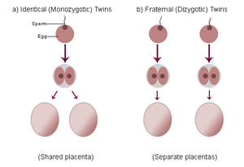
Twin studies
Psychologists are interested in studying twins in order to investigate the genetic basis of behaviour
Zygote
A fertilised egg
Monozygotic (MZ)
One zygote – these twins are formed when a fertilised cell splits into two and forms two separate embryos
Dizygotic (DZ)
Two zygotes – these twins are formed when two separate eggs both become fertilised by different sperm cells

Slide 37
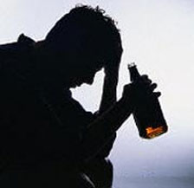
Family studies
1869 - Francis Galton ‘…all natural abilities are inherited’
This is a simplistic viewpoint – Galton later had to agree that any resemblance between family relatives could be a result of both genes and shared environment
However, with alcoholism for example, there is a suggestion of a biological predisposition to the addiction

Slide 38
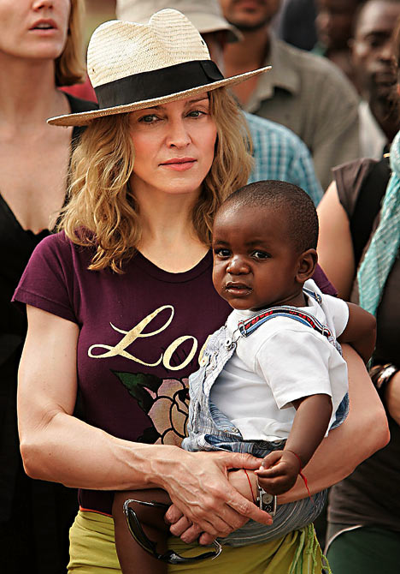
Adoption studies
These studies involve comparing a trait or characteristic between adopted children and their biological or adoptive parents.

Slide 39
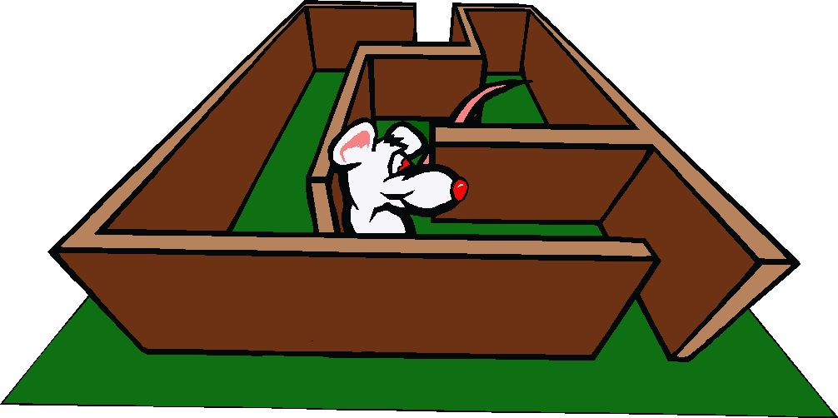
Selective breeding
This method involves artificially selecting male and female animals for a particular trait.
These animals are then put together in order to breed and produce offspring.
Selective breeding has been used to demonstrate how a number of behavioural characteristics may have a genetic basis. e.g. ‘maze bright’ rats

Slide 40
Stress
Fight or Flight
We will cover in detail.
Aggression too much testosterone!

Slide 41
Some questions?
Explain what is meant by genotype and phenotype.
Outline the influence of genes on behaviour.
Outline the influence of biological structures and neurochemistry on behaviour.
Explain the difference between genotype and phenotype.
Outline the relationship between evolution and behaviour.

Slide 42
Recessive and dominant genes
A gene can be recessive or dominant.
A recessive gene only shows if the individual has two copies of the recessive gene. For example, the gene for blue eyes is recessive. You need two copies of the gene to have blue eyes.
A dominant gene always shows, even if the individual only has one copy of the gene. For example, the gene for brown eyes is dominant. You only need one copy of the gene to have brown eyes (and two copies will still give you brown eyes!).

Slide 43
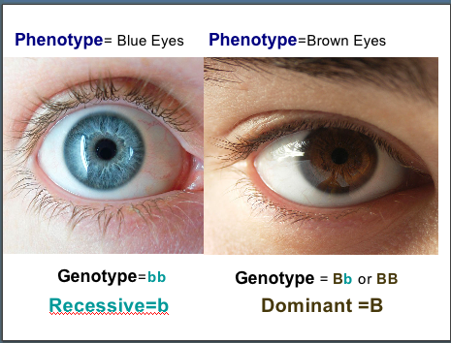

Slide 44
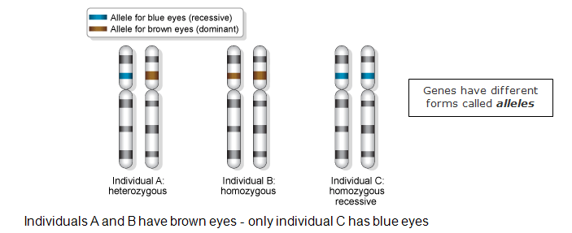
Example

Slide 45
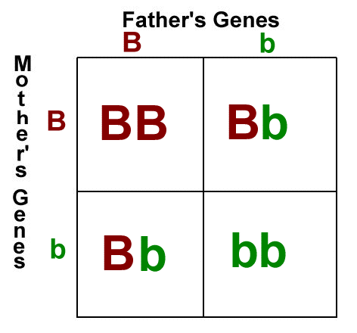
Heterozygous and homozygous genes
heterozygous – the genotype consists of two different genes, for example Bb
homozygous - the genotype consists of two genes that are the same, for example BB

Slide 46
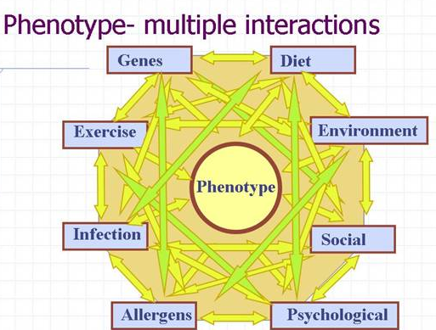
Summary
Genotype is something you cannot see with your eyes (examples: dominant, recessive, heterozygous genes, etc.)
Phenotype are things that can be seen with your eyes. (example: colours, growth, etc.)

Slide 47
Debate about nature and nurture.

Slide 48
Research methods
The biological approach draws on concepts from the hard sciences and research tends to be highly scientific in nature
The most common methods include laboratory experiments and observations
Objective brain recording and scanning techniques are also used, Psychopatholgy

Slide 49
Strengths of biological approach
It is a scientific approach. This suggests that we can find cause and effect relationships of both physiology and behaviour.
Scientific approach lends credence to study of psychology – establishes psychology as a respectable science
Impact of biology on behaviour can lead to treatment and intervention to those suffering
Understanding how an abnormal brain works can shed light on normal brain functioning
Measurements can be objective as it can be performed by machines which have no vested interest in the outcome e.g. PET scans, EEGs etc. Use of complex machinery allows accurate and precise measurements

Slide 50
Limitations of biological approach
It is a deterministic approach as it believes that we are determined by our physiological, genetic or evolutionary make-up. Thus stating that there is no free will.
This approach is reductionist by stating that all human behaviour can be explained through biological processes and we are therefore not unique as individuals. It is also dehumanising to present humans as ‘biological machines’
Biological approach ignores the role of the environment etc. it should be used in combination which is known as the biosocial approach.
Research may focus on rare conditions that have little impact on the everyday lives of most people
Complex machinery operated by humans and therefore measurements could be subject to human error
Correlations frequently employed – cannot determine cause and effect
Small or restricted samples make findings difficult to generalise
Laboratory experiments lack ecological validity

Slide 51
Can you?
Explain what is meant by genotype and phenotype (2 marks each)
Outline the influence of genes on behaviour (3 marks)
Using an example, explain how neurochemistry can influence behaviour (3 marks)
Outline the relationship between evolution and behaviour (4 marks)
Outline two weaknesses of the biological approach in psychology (4 marks)

Slide 52
Essay title
Can you answer the question?
Discuss the biological approach in psychology. Refer to at least one other approach in your answer (12 marks)

Slide 53
Homework
Ensure you have written up your class notes to include the following:
The assumptions of the biological approach
the influence of genes, biological structures and neurochemistry on behaviour,
genotype and phenotype,
genetic basis of behaviour,
evolution and behaviour.
The strengths and weaknesses of the approach

Slide 54
The psychodynamic approach
The role of the unconscious, the structure of personality, that is ID, ego and superego, defence mechanisms including repression, denial and displacement, psychosexual stages.

Slide 55
Psychodynamic
Main assumption is that abnormality is a result of unresolved unconscious conflicts originating from childhood experiences:
Fixation at one or more of the psychosexual stages of development – oral, anal, phallic, latent, genital e.g. fixation at oral stage could lead to eating disorders
An imbalance between the 3 parts of the mind – id, ego and superego – e.g. if superego is too strong, the person may suffer anxiety disorders
Overuse of ego defence mechanisms – denial, repression, reaction formation, etc. e.g. overuse of denial could lead to a break from reality (schizophrenia)

Slide 56
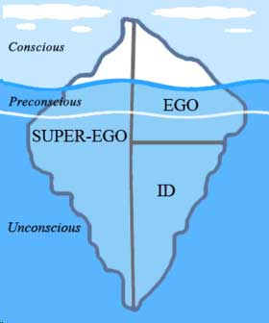
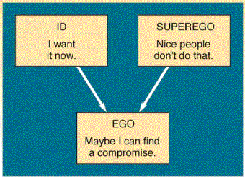
Freud (Notes)
ID: The id demands immediate satisfaction and when this happens we experience pleasure, when it is denied we experience ‘unpleasure’ or pain. The id is not affected by reality, logic or the everyday world.
Ego: The ego develops in order to mediate between the unrealistic id and the external real world. It is the decision making component of personality. Ideally the ego works by reason whereas the id is chaotic and totally unreasonable.
Superego: The superego incorporates the values and morals of society which are learned from one's parents and others. It develops around the age of 3 – 5 during the phallic stage of psychosexual development.
The superego's function is to control the id's impulses, especially those which society forbids, such as sex and aggression. It also has the function of persuading the ego to turn to moralistic goals rather than simply realistic ones and to strive for perfection.

Slide 57
Examiners Id, Ego And Superego
the id: Focuses on self (selfish), irrational and emotional, deals with feelings and needs, seeks pleasure/hedonistic (reference to ‘pleasure principle), formed from birth-18mo, unconscious part of the mind
the ego: Rational, balancing the id and superego, reference to ‘reality principle’, formed between 18mo-3yrs, conscious part of the mind
the superego: Reference to ‘morality principle’, acts as the conscience or moral guide, based on parental and societal values, formed between 3-6yrs, unconscious part of the mind

Slide 58
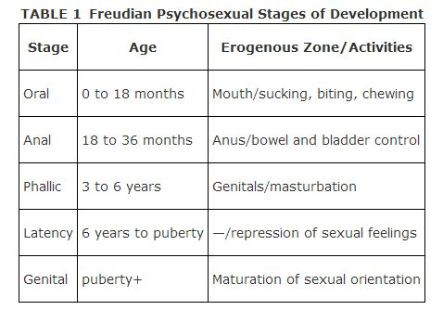
Psychosexual Development (No Notes)

Slide 59
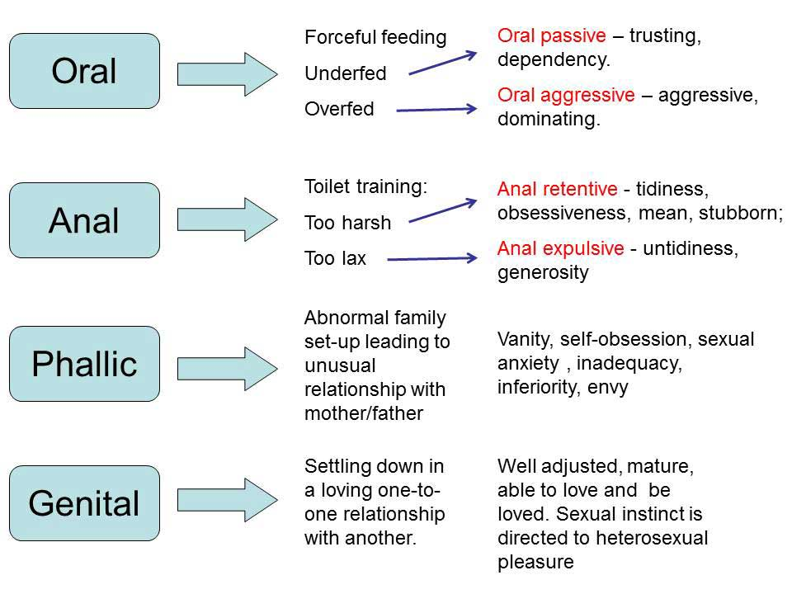

Slide 60
Repression*
This was the first defence mechanism that Freud discovered, and arguably the most important. Repression is an unconscious mechanism employed by the ego to keep disturbing or threatening thoughts from becoming conscious. Thoughts that are often repressed are those that would result in feelings of guilt from the superego. For example, in the Oedipus complex, aggressive thoughts about the same sex parents are repressed.
This is not a very successful defence in the long term since it involves forcing disturbing wishes, ideas or memories into the unconscious, where, although hidden, they will create anxiety.

Slide 61
Projection
This involves individuals attributing their own thoughts, feeling and motives to another person. Thoughts most commonly projected onto another are the ones that would cause guilt such as aggressive and sexual fantasies or thoughts. For instance, you might hate someone, but your superego tells you that such hatred is unacceptable. You can 'solve' the problem by believing that they hate you.

Slide 62
Displacement *
Displacement is the redirection of an impulse (usually aggression) onto a powerless substitute target. The target can be a person or an object that can serve as a symbolic substitute. Someone who feels uncomfortable with their sexual desire for a real person may substitute a fetish. Someone who is frustrated by his or her superiors may go home and kick the dog, beat up a family member, or engage in cross-burnings.

Slide 63
Sublimation
This is similar to displacement, but takes place when we manage to displace our emotions into a constructive rather than destructive activity. This might for example be artistic. Many great artists and musicians have had unhappy lives and have used the medium of art of music to express themselves. Sport is another example of putting our emotions (e.g. aggression) into something constructive.
For example, fixation at the oral stage of development may later lead to seeking oral pleasure as an adult through sucking ones thumb, pen or cigarette. Also, fixation during the anal stage may cause a person to sublimate their desire to handle faeces with an enjoyment of pottery.
Sublimation for Freud was the cornerstone of civilized life, arts and science are all sublimated sexuality. (NB. this is a value laden concept, based on the aspirations of a European society at the end of the 1800 century).

Slide 64
Denial *
Denial involves blocking external events from awareness. If some situation is just too much to handle, the person just refuses to experience it. As you might imagine, this is a primitive and dangerous defence - no one disregards reality and gets away with it for long! It can operate by itself or, more commonly, in combination with other, more subtle mechanisms that support it. For example, smokers may refuse to admit to themselves that smoking is bad for their health.

Slide 65
Regression
This is a movement back in psychological time when one is faced with stress. When we are troubled or frightened, our behaviours often become more childish or primitive. A child may begin to suck their thumb again or wet the bed when they need to spend some time in the hospital. Teenagers may giggle uncontrollably when introduced into a social situation involving the opposite sex.

Slide 66
Rationalization
Rationalization is the cognitive distortion of "the facts" to make an event or an impulse less threatening. We do it often enough on a fairly conscious level when we provide ourselves with excuses. But for many people, with sensitive egos, making excuses comes so easy that they never are truly aware of it. In other words, many of us are quite prepared to believe our lies.

Slide 67
Reaction Formation
This is where a person goes beyond denial and behaves in the opposite way to which he or she thinks or feels. By using the reaction formation the id is satisfied while keeping the ego in ignorance of the true motives. Conscious feelings are the opposite of the unconscious. Love - hate. Shame - disgust and moralizing are reaction formation against sexuality.
Usually a reaction formation is marked by showiness and compulsiveness. For example, Freud claimed that men who are prejudice against homosexuals are making a defense against their own homosexual feelings by adopting a harsh anti-homosexual attitude which helps convince them of their heterosexuality. Other examples include:
* The dutiful daughter who loves her mother is reacting to her Oedipus hatred of her mother.
* Anal fixation usually leads to meanness, but occasionally a person will react against this (unconsciously) leading to over-generosity.

Slide 68
Little Hans
Prep: look up little Hans

Slide 69
Evaluation of the psychoanalytic model
Strengths
The psychodynamic model has a number of strengths which account for its enduring popularity:
Many observations of psychodynamic therapists appear to be born out in everyday life, e.g., defence mechanisms
Many people with psychological disturbances do recollect childhood traumas
Freudian theory provides a comprehensive framework to describe human personality
Freud ‘rehumanised’ the distressed, making their suffering more comprehensible to the rest of society
By developing a method of treatment, Freud encouraged a more optimistic view regarding psychological distress. Mental illness could, in some cases at least, be treated!

Slide 70
Weaknesses of the psychoanalytic model are:
The tendency to ignore the patient’s current problems by focusing on past conflicts (though this is not true of many later versions of psychoanalysis)
A lack of scientific evidence concerning major theoretical assumptions
As the source of many of the conflicts are often parents, there is a tendency to give a lot of responsibility to parents for the psychological health of their children
Psychodynamic theory underestimates the role of situation and context, and overemphasises internal instincts and conflicts

Slide 71
Question
Outline key features of the psychodynamic approach to psychopathology.
Psychopathology is a term which refers to either the study of mental illness or mental distress or the manifestation of behaviours and experiences which may be indicative of mental illness or psychological impairment.

Slide 72
Answer
Key features include: • Role of the unconscious • Structure of the mind: id, ego, superego • Psychosexual stages of development • Use of defence mechanisms • Early childhood experiences affecting adult behaviour. Breadth/depth trade off; candidates may offer several features in less detail or a few features but in more detail.
Must relate to mental disorders

Slide 73
Psychodynamic Approach Assumptions
Our behaviour and feelings are powerfully affected by unconscious motives.
Our behaviour and feelings as adults (including psychological problems) are rooted in our childhood experiences.
All behaviour has a cause (usually unconscious), even slips of the tongue. Therefore all behaviour is determined.
Personality is made up of three parts (i.e. tripartite): the id, ego and super-ego.
Behaviour is motivated by two instinctual drives: Eros (the sex drive & life instinct) and Thanatos (the aggressive drive & death instinct). Both these drives come from the “id”.
Parts of the unconscious mind (the id and superego) are in constant conflict with the conscious part of the mind (the ego). This conflict creates anxiety, which could be dealt with by the ego’s use of defence mechanisms.
Personality is shaped as the drives are modified by different conflicts at different times in childhood (during psychosexual development).

Slide 74
Psychodynamic Therapies
Psychoanalysis involves a range of techniques that aims to bring material from the unconscious into the conscious.
Free Association
  The client is encouraged to express anything that comes into their mind and follow any associations that occur to them. The client must not censor the material, defence mechanisms will be lowered. The therapist identifies key themes from the free association to analyze later.
Dream Analysis
  "Dream are the royal road to the unconscious."
  During dreams the barriers to the unconscious are lifted.
  By analysing the dreams they can find out what is in your unconscious.
  Themes are identified and uncoded.
  Obvious content - Manifest content.
  Actual meaning lies beneath this - Latent content.
  Dreamwork to the process that turns latent into obvious.
  R o r s c h a c h T e s t Ink Blots is a type of projective test.
  Link

Slide 75
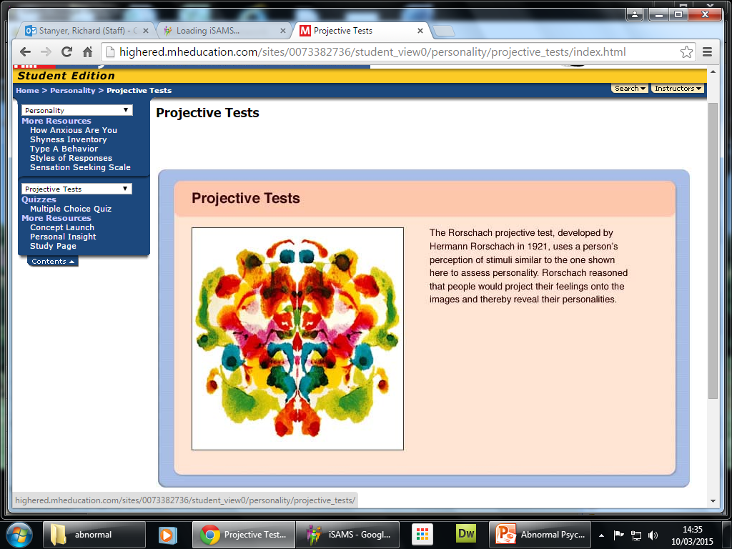

Slide 76


Evaluation
Hugely influential – many psychodynamic terms are in everyday use and Freud was the first to suggest ‘talking therapy’ – the basis for modern counselling
Doesn’t consider the role of adult experiences in abnormality e.g. divorce, bereavement, etc.
Based on case studies – may not be generalisable to general population
Blames parents for mental illness – consequences of their child rearing practices e.g. potty training
Case studies use retrospective self report data – P’s may not be truthful/may not remember accurately
Criticised as being unscientific because much of the theory is impossible to measure (not observable)
Often accused of being deterministic because it suggests that we have no control over our adult life – it is predetermined by childhood experiences

Slide 77
Question
Psychoanalysis is a beneficial therapy for some people. However, as with all therapies, it has limitations. Evaluate psychoanalysis as a therapy

Slide 78
Answer
The evaluation might consider:
  Therapy is very time-consuming and is unlikely to provide answers quickly.
  People must be prepared to invest a lot of time and money into the therapy; they must be motivated.
  They might discover some painful and unpleasant memories that had been repressed, which causes them more distress.
  This type of therapy does not work for all people and for all types of disorders. Evaluation which is focused on the psychodynamic approach can be credited as long as it is used to evaluate the therapy.

Slide 79
Question
There are various types of psychological therapy for treating abnormality.
  12 (a) Outline what is involved in psychoanalysis.

Slide 80
Answer
Psychoanalysis involves a range of techniques that aims to bring material from the unconscious into the conscious. These could include free association, dream analysis and projective tests.

Slide 81
Question
Outline two techniques used in psychoanalysis. 4

Slide 82
Answer
Psychoanalysis involves a range of techniques that aims to bring material from the unconscious into the conscious. These could include free association, dream analysis and projective tests. However, examiners should be mindful that psychoanalysis is a broad term and can include a wide range of different techniques. Students must offer two different techniques; they do not have to be outlined in equal detail. If only one technique, maximum 2 marks.

Slide 83
Humanistic psychology:
free will, self-actualisation and Maslow’s hierarchy of needs, focus on the self, congruence, the role of conditions of worth. The influence on counselling psychology.

Slide 84
free will
Not all behaviour is determined
EG: when two chemicals react there is no sense in imagining that they could behave in any other way than the way they do. However when two people come together they could agree, fall out, come to a compromise, start a fight and so on. The permutations are endless and in order to understand their behaviour we would need to understand what each party to the relationship chooses to do.
Personal agency is the humanistic term for the exercise of free will. Personal agency refers to the choices we make in life, the paths we go down and their consequences.
Free will is necessary if we are to become fully functional human beings. Maslow and Rogers see self-actualisation as a unique human need and form of motivation setting us apart from all other species.

Slide 85
Self-actualisation
The achievement of one's full potential through creativity, independence, spontaneity, and a grasp of the real world.
Maslow describes self-actualization as the pinnacle need. Self-actualization occurs when you maximize your potential, doing the best that you are capable of doing. Maslow studied individuals whom he believed to be self-actualized, including Abraham Lincoln, Thomas Jefferson, and Albert Einstein, to derive the common characteristics of the self-actualized person. Here are a selection of the most important characteristics, from his book Motivation and Personality:

Slide 86
Here are a selection of the most important characteristics, from his book Motivation and Personality:
1) Self-actualized people embrace the unknown and the ambiguous.
They are not threatened or afraid of it; instead, they accept it, are comfortable with it and are often attracted by it. They do not cling to the familiar. Maslow quotes Einstein:
“The most beautiful thing we can experience is the mysterious.”

Slide 87
2) They accept themselves, together with all their flaws.
She perceives herself as she is, and not as she would prefer herself to be. With a high level of self-acceptance, she lacks defensiveness, pose or artificiality. Eventually, shortcomings come to be seen not as shortcomings at all, but simply as neutral personal characteristics.
“They can accept their own human nature in the stoic style, with all its shortcomings, with all its discrepancies from the ideal image without feeling real concern [...] One does not complain about water because it is wet, or about rocks because they are hard [...] simply noting and observing what is the case, without either arguing the matter or demanding that it be otherwise.”
Nonetheless, while self-actualized people are accepting of shortcomings that are immutable, they do not feel ashamed or regretful about changeable deficits and bad habits.

Slide 88
3) They prioritize and enjoy the journey, not just the destination.
“[They] often [regard] as ends in themselves many experiences and activities that are, for other people, only means. Our subjects are somewhat more likely to appreciate for its own sake, and in an absolute way, the doing itself; they can often enjoy for its, own sake the getting to some place as well as the arriving. It is occasionally possible for them to make out of the most trivial and routine activity an intrinsically enjoyable game or dance or play.”

Slide 89
4) While they are inherently unconventional, they do not seek to shock or disturb.
Unlike the average rebel, the self-actualized person recognizes:
“... the world of people in which he lives could not understand or accept [his unconventionality], and since he has no wish to hurt them or to fight with them over every triviality, he will go through the ceremonies and rituals of convention with a good-humoured shrug and with the best possible grace [... Self-actualized people would] usually behave in a conventional fashion simply because no great issues are involved or because they know people will be hurt or embarrassed by any other kind of behaviour.”

Slide 90
5) They are motivated by growth, not by the satisfaction of needs.
While most people are still struggling in the lower rungs of the ‘Hierarchy of Needs,’ the self-actualized person is focused on personal growth.
“Our subjects no longer strive in the ordinary sense, but rather develop. They attempt to grow to perfection and to develop more and more fully in their own style. The motivation of ordinary men is a striving for the basic need gratifications that they lack.”

Slide 91
6) Self-actualized people have purpose.
“[They have] some mission in life, some task to fulfil, some problem outside themselves which enlists much of their energies. [...] This is not necessarily a task that they would prefer or choose for themselves; it may be a task that they feel is their responsibility, duty, or obligation. [...] In general these tasks are non-personal or unselfish, concerned rather with the good of mankind in general.”

Slide 92
7) They are not troubled by the small things.
Instead, they focus on the bigger picture.
“They seem never to get so close to the trees that they fail to see the forest. They work within a framework of values that are broad and not petty, universal and not local, and in terms of a century rather than the moment.[...] This impression of being above small things [...] seems to impart a certain serenity and lack of worry over immediate concerns that make life easier not only for themselves but for all who are associated with them.”

Slide 93
8) Self-actualized people are grateful.
They do not take their blessings for granted, and by doing so, maintain a fresh sense of wonder towards the universe.
“Self-actualizing people have the wonderful capacity to appreciate again and again, freshly and naïvely, the basic goods of life, with awe, pleasure, wonder, and even ecstasy, however stale these experiences may have become to others [...] Thus for such a person, any sunset may be as beautiful as the first one, any flower may be of breath-taking loveliness, even after he has seen a million flowers. [...] For such people, even the casual workaday, moment-to-moment business of living can be thrilling.”

Slide 94
9) They share deep relationships with a few, but also feel identification and affection towards the entire human race.
“Self-actualizing people have deeper and more profound interpersonal relations than any other adults [...] They are capable of more fusion, greater love, more perfect identification, more obliteration of the ego boundaries than other people would consider possible. [...This devotion] exists side by side with a widespreading [...] benevolence, affection, and friendliness. These people tend to be kind [and friendly] to almost everyone [...] of suitable character regardless of class, education, political belief, race, or color.”

Slide 95
10) Self-actualized people are humble.
“They are all quite well aware of how little they know in comparison with what could be known and what is known by others. Because of this it is possible for them without pose to be honestly respectful and even humble before people who can teach them something.”

Slide 96
11) Self-actualized people resist enculturation.
They do not allow themselves to be passively moulded by culture — they deliberate and make their own decisions, selecting what they see as good, and rejecting what they see as bad. They neither accept all, like a sheep, nor reject all, like the average rebel. Self-actualized people:
“make up their own minds, come to their own decisions, are self-starters, are responsible for themselves and their own destinies. [...] too many people do not make up their own minds, but have their minds made up for them by salesmen, advertisers, parents, propagandists, TV, newspapers and so on.”
Because of their self-decision, self-actualized people have codes of ethics that are individualized and autonomous rather than being dictated by society.
“They are the most ethical of people even though their ethics are not necessarily the same as those of the people around them [...because] the ordinary ethical behaviour of the average person is largely conventional behaviour rather than truly ethical behaviour.”

Slide 97
12) Despite all this, self-actualized people are not perfect.
“There are no perfect human beings! Persons can be found who are good, very good indeed, in fact, great. [...] And yet these very same people can at times be boring, irritating, petulant, selfish, angry, or depressed. To avoid disillusionment with human nature, we must first give up our illusions about it.”

Slide 98
Maslow
Every person is capable and has the desire to move up the hierarchy toward a level of self-actualization. Unfortunately, progress is often disrupted by failure to meet lower level needs. Life experiences, including divorce and loss of job may cause an individual to fluctuate between levels of the hierarchy. Therefore, not everyone will move through the hierarchy in a uni-directional manner but may move back and forth between the different types of needs.
Maslow noted only one in a hundred people become fully self-actualized because our society rewards motivation primarily based on esteem, love and other social needs

Slide 99
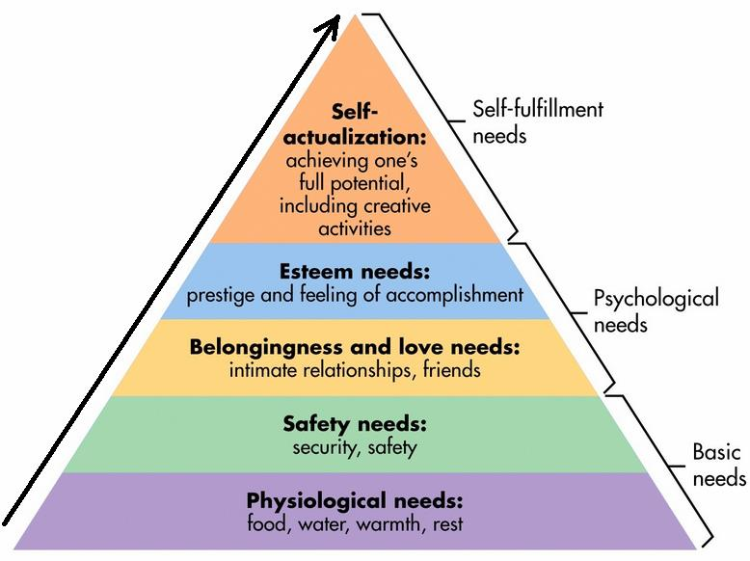

Slide 100
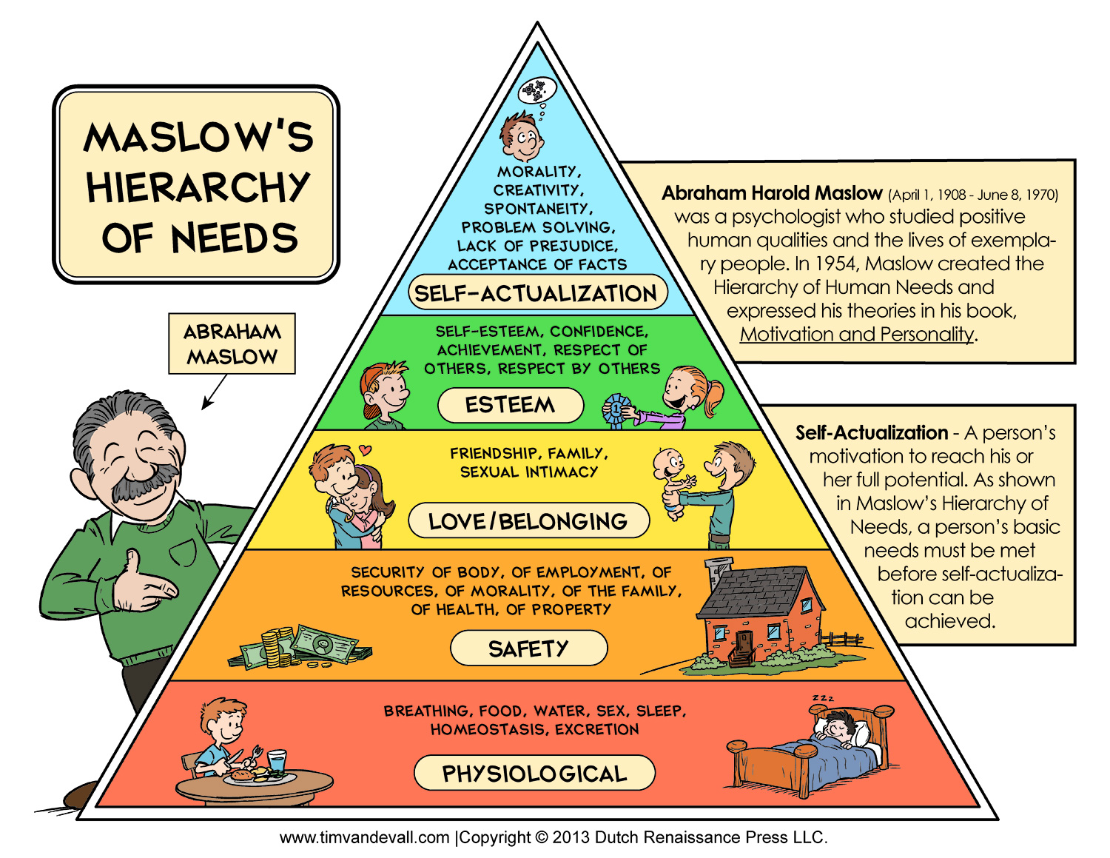

Slide 101
Carl Rogers
Central to Rogers' personality theory is the notion of self or self-concept. This is defined as "the organized, consistent set of perceptions and beliefs about oneself."
The self is the humanistic term for who we really are as a person. The self is our inner personality, and can be likened to the soul, or Freud's psyche. The self is influenced by the experiences a person has in their life, and out interpretations of those experiences. Two primary sources that influence our self-concept are childhood experiences and evaluation by others.
According to Rogers (1959), we want to feel, experience and behave in ways which are consistent with our self-image and which reflect what we would like to be like, our ideal-self. The closer our self-image and ideal-self are to each other, the more consistent or congruent we are and the higher our sense of self-worth.
A person is said to be in a state of incongruence if some of the totality of their experience is unacceptable to them and is denied or distorted in the self-image.
The humanistic approach states that the self is composed of concepts unique to ourselves. The self-concept includes three components:
Self-worth (or self-esteem) – what we think about ourselves. Rogers believed feelings of self-worth developed in early childhood and were formed from the interaction of the child with the mother and father.
Self-image – How we see ourselves, which is important to good psychological health. Self-image includes the influence of our body image on inner personality. At a simple level, we might perceive ourselves as a good or bad person, beautiful or ugly. Self-image affects how a person thinks, feels and behaves in the world.
Ideal self – This is the person who we would like to be. It consists of our goals and ambitions in life, and is dynamic – i.e., forever changing. The ideal self in childhood is not the ideal self in our teens or late twenties etc.

Slide 102
Self Worth and Positive Regard
Carl Rogers (1951) viewed the child as having two basic needs: positive regard from other people and self-worth.
Self-worth may be seen as a continuum from very high to very low. For Carl Rogers (1959) a person who has high self-worth, that is, has confidence and positive feelings about him or herself, faces challenges in life, accepts failure and unhappiness at times, and is open with people.
A person with low self-worth may avoid challenges in life, not accept that life can be painful and unhappy at times, and will be defensive and guarded with other people.

Slide 103
Positive regard
Positive regard is to do with how other people evaluate and judge us in social interaction. Rogers made a distinction between unconditional positive regard and conditional positive regard.
Unconditional positive regard is where parents, significant others (and the humanist therapist) accepts and loves the person for what he or she is. Positive regard is not withdrawn if the person does something wrong or makes a mistake.
The consequences of unconditional positive regard are that the person feels free to try things out and make mistakes, even though this may lead to getting it worse at times. People who are able to self-actualize are more likely to have received unconditional positive regard from others, especially their parents in childhood.
Conditional positive regard is where positive regard, praise, and approval, depend upon the child, for example, behaving in ways that the parents think correct. Hence the child is not loved for the person he or she is, but on condition that he or she behaves only in ways approved by the parent(s).
At the extreme, a person who constantly seeks approval from other people is likely only to have experienced conditional positive regard as a child.

Slide 104
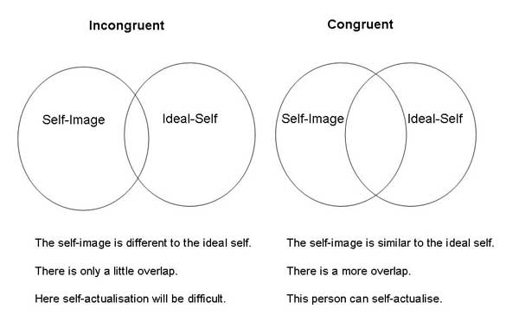
Congruence
A person’s ideal self may not be consistent with what actually happens in life and experiences of the person. Hence, a difference may exist between a person’s ideal self and actual experience. This is called incongruence.
Where a person’s ideal self and actual experience are consistent or very similar, a state of congruence exists. Rarely, if ever, does a total state of congruence exist; all people experience a certain amount of incongruence.

Slide 105
Counselling psychology
Counselling psychology focuses on providing therapeutic treatments to clients who experience a wide variety of symptoms, to help people of all ages deal with emotional, social, developmental, and other life concerns. Humanistic psychology has provided several approaches to counselling and therapy. For example, person-centered therapy was developed by Carl Rogers. This is non-directive and the client is encouraged to discover their own solutions within a warm, supportive and non-judgemental environment.

Slide 106
two assumptions of the humanistic approach
Each person is a rational and conscious being and not dominated by unconscious primitive instincts – explanation might focus on the principles of determinism and reductionism in science.
A person’s subjective experience and understanding of the world is of greater importance to understanding the person than objective reality – explanation might focus on empiricism in science.
Humans should be viewed as a whole and not reduced to component parts – explanation might focus on reductionism in science.
Humans strive towards achieving self-actualisation- explanation might focus on the need for objectivity in science eg operational definition vs. subjectively defined; hypothetical construct; no objective measure.
Each person is unique – explanation might focus on general laws of behaviour / nomothetic approach.

Slide 107
Humanistic psychology:
free will, self-actualisation and Maslow’s hierarchy of needs, focus on the self, congruence, the role of conditions of worth. The influence on counselling psychology.

Slide 108
Issues and debates in psychology
Gender and culture in psychology – universality and bias. Gender bias including androcentrism and alpha and beta bias; cultural bias, including ethnocentrism and cultural relativism.
Free will and determinism: hard determinism and soft determinism; biological, environmental and psychic determinism. The scientific emphasis on causal explanations.
The nature-nurture debate: the relative importance of heredity and environment in determining behaviour; the interactionist approach.
Holism and reductionism: levels of explanation in psychology. Biological reductionism and environmental (stimulus-response) reductionism.
Idiographic and nomothetic approaches to psychological investigation.
Ethical implications of research studies and theory, including reference to social sensitivity.

Slide 109
universality
The propensity to presume that one's personal traits and personality features, inclusive of outlooks and morals, are shared in the main social group or cultural society.
In regard to crowd environments, the propensity for people to presume that abnormal, uncommon actions are permittable since many other people in the environment or scenario are engaging in such acts.

Slide 110
Androcentrism
Androcentrism refers to perspectives concerned with masculinity or men to the exclusion of other perspectives.
gynocentric

Slide 111
Example: A Look at Androcentric Bias
Tom is a researcher interested in studying romantic relationships. He conducts a study that asks each participant to rate characteristics he or she looks for when choosing a partner.
Four hundred males and forty females complete Tom's study. He finds that seventy-five percent of the males chose physical appearance as the most important characteristic. The women were evenly split among their preferences - primarily finances, a family-oriented demeanor and emotional openness. In fact, thirty-three percent of the women selected each of the three on their questionnaires. Tom analyzes his research findings and concludes that when men and women choose a romantic partner, physical attraction is the most important factor. This is an example of

Slide 112
Alpha and beta bias
Alpha Bias = Are differences
Beta Bias = Bull****** there are no differences
Alpha bias – this occurs when the differences between men and women are exaggerated.
Beta bias – this occurs when the differences between men and women are minimised.

Slide 113
Ethnocentrism
Evaluation of other cultures according to preconceptions originating in the standards and customs of one's own culture.

Slide 114
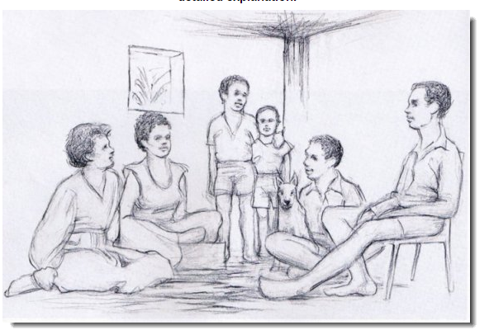
What do you see.

Slide 115
Cultural relativism
Is the principle that an individual's beliefs and activities should be understood by others in terms of that individual's own culture.
Perception – A cow is a bug. A window is a basket.

Slide 116
Free will and determinism
Some approaches in psychology see the source of determinism as being outside the individual, a position known as environmental determinism. For example, Bandura (1961) showed that children with violent parents will in turn become violent parents through observation and imitation.
Behaviourist view?
Biological View?

Slide 117
Free Will - Humanistic
Cognitive psychologists are also inclined to attribute importance to free will, and adopt a soft determinism view. However, whereas humanists are especially interested in our choice of ends (how each of us sees the road to self actualization) cognitive psychologists are more inclined to focus on the choice of means. In other words for them it is the rational processing of information which goes into the making of a decision which is their main interest.

Slide 118
Psychic determinism
Psychic determinism is a type of determinism that theorises that all mental processes are not spontaneous but are determined by the unconscious or preexisting mental complexes. It relies on the causality principle applied to psychic occurrences in which nothing happens by chance or by accidental arbitrary ways.
WHO

Slide 119
Read through
Psychologists who take the free will view suggest that determinism removes freedom and dignity, and devalues human behaviour. By creating general laws of behaviour, deterministic psychology underestimates the uniqueness of human beings and their freedom to choose their own destiny.
There are important implications for taking either side in this debate. Deterministic explanations for behaviour reduce individual responsibility. A person arrested for a violent attack for example might plead that they were not responsible for their behaviour – it was due to their upbringing, a bang on the head they received earlier in life, recent relationship stresses, or a psychiatric problem. In other words, their behaviour was determined.
The deterministic approach also has important implications for psychology as a science. Scientists are interested in discovering laws which can then be used to predict events. This is very easy to see in physics, chemistry and biology. As a science, psychology attempts the same thing – to develop laws, but this time to predict behaviour If we argue against determinism, we are in effect rejecting the scientific approach to explaining behaviour
Clearly, a pure deterministic or free will approach does not seem appropriate when studying human behaviour Most psychologists use the concept of free will to express the idea that behaviour is not a passive reaction to forces, but that individuals actively respond to internal and external forces.
The term soft determinism is often used to describe this position, whereby people do have a choice, but their behaviour is always subject to some form of biological or environmental pressure.

Slide 120
The term soft determinism is often used to describe this position, whereby people do have a choice, but their behaviour is always subject to some form of biological or environmental pressure.

Slide 121
The scientific emphasis on causal explanations.
IS?

Slide 122
The nature-nurture debate: the relative importance of heredity and environment in determining behaviour; the interactionist approach.
The so-called “nature–nurture debate” in psychology has a long history, stretching back into philosophical debate about the nature of humankind. The term “nature” refers to behaviour that is determined by inherited factors. “Nurture” is the influence of any environmental factors including learning. The debate is sometimes called heredity versus environment.
Schizophrenia – Nature or Nurture

Slide 123
The interactionist approach.
The interactionism perspective states that values are determined by social interaction. Interactionism does not claim actions to be inherently right or wrong. The value of an act is socially prescribed. For instance, teen alcohol consumption may be legal and socially acceptable in one country while illegal and frowned upon in another. These moral assumptions are personal convictions received through social interaction.
Interactionism also has a unique perspective on research methodology. It questions the validity of statistic data, claiming that statistics do not give an accurate picture of human experience. Interactionist theory rejects the use of hypotheses, asserting that a hypothesis makes a study biased by steering it in a predetermined direction. Interactionists prefer methods like unstructured interviews, covert participant observation and content analysis.

Slide 124
Holism and reductionism: levels of explanation in psychology. Biological reductionism and environmental (stimulus-response) reductionism.

Slide 125
Idiographic and nomothetic approaches to psychological investigation.
Explanation
Funny

Slide 126
Idiographic Approach - an approach or method in psychology that is concerned with understanding behaviour through studying individual cases.
Nomothetic approach- an approach or method in psychology that is concerned with developing general laws of behaviour that apply to all people.

Slide 127
Idiographic Approach
The case study method, which provide a complete and global understanding of the individual is favoured. Other methods include unstructured interviews as well as the less mainstream methods such as self report, introspection and reflection and the use of autobiographies and personal documents such as diaries and letters. In psychoanalysis free association and dream analysis are acceptable investigating tools however it is important to note that numerical measurement is not excluded in the idiographic approach: it is just that the main form of data is collected is description rather than measurement. Assets map details doodles notes outlook photo frame Learning Objectives Features and methods of investigation The key features of the approach is the individual and the recognition of their uniqueness.
This includes numerous aspects of individuality e.g. private subjective and conscious experiences, feelings beliefs and values
This also involves investigating individuals in a personal and detailed way, methods of investigation tend to be qualitative .

Slide 128
Strengths
The idiographic approach focuses on the subjective experiences of the person making the individual feeling valued and unique. Each person is valued as an individual rather than seen as one amongst many.
The idiographic approach provides detailed psychohistories and attempts to understand the many influences on how they come to be as they are.
Humanistic psychology uses an idiographic approach to enable people to develop to their full potential.

Slide 129
Weaknesses
It is difficult to generalise from detailed subjective knowledge about one person.
The idiographic approach is often regarded as non-scientific, as subjective experience cannot be empirically tested.
The idiographic approach largely neglects biological, especially genetic, influences.

Slide 130
Nomothetic approach-
The defining features of this approach are similarities between people and laws that govern
behaviour. This approach emphasises general laws of behaviour that can be applied to large
populations of people.
According to Radford and Kirby these general laws can be of three kinds;
Classifying people into various groups For example the DSM-IV which provides a means of classifying more than 200 types of disorders, classification is based on a person’s symptoms.
Establishing principles of behaviour that can be applied to people in general the principles or laws of learning apply to people in a similar way, research into behaviour as such as obedience and conformity experiments has resulted in general principles of behaviour that apply to all.
Establishing dimensions on which people can be placed and compared For example IQ scales
measure people’s intelligence resulting in scores that allow for comparisons between people.

Slide 131
Nomothetic research
Nomothetic research uses scientific and quantitative methods of investigation, usually experiments.
Theories generate hypotheses that are then tested under controlled experimental conditions. The findings of experiments and other quantitative methods, such as observations are provided by a large number of people. Features of the Nomothetic approach. Aim- To investigate how heredity might affect alcohol abuse. (Twin and adoption studies have shown that heredity is linked to alcohol abuse)
Method- Male participants were categorised as either ‘high risk’ or ‘low risk’ for becoming an alcoholic. (Depending on their close relatives alcohol abuse) This was a matched pairs design, they was matched on the basis of important variables such as age, amount of alcohol intake per week, education and race. All participants received either a placebo or a strong alcohol drink. One hour after taking the drink all participants had to rate their feeling of drunkenness. All participants were tested during the late adolescent or early adult years before any of them had developed a drinking problem.
Results- Participants in the ‘high risk’ group who had taken the alcoholic drink gave lower ratings of drunkenness levels than those in the ‘low risk’ group. The placebo group, all participants reported low levels of drunkenness.
Conclusion- People who are genetically prone to becoming problem drinkers may have an impaired ability to perceive the effects of alcohol and fail to notice the symptoms of drunkenness early enough to stop drinking.

Slide 132
Evaluation- This study has many features of the nomothetic approach. It isolated a major variable: the risk for alcoholism. The study was well controlled, the date could be analysed in terms of group scores, the findings could be statistically analysed and be generalised to others who differ in their alcoholism, allowing predictions to be made for people who differ on the high-low risk dimension.
However the conclusions are in general terms only, they cannot predict the outcome for a particular individual.

